Slide 1
LAB 2 CSE 307

Slide 2
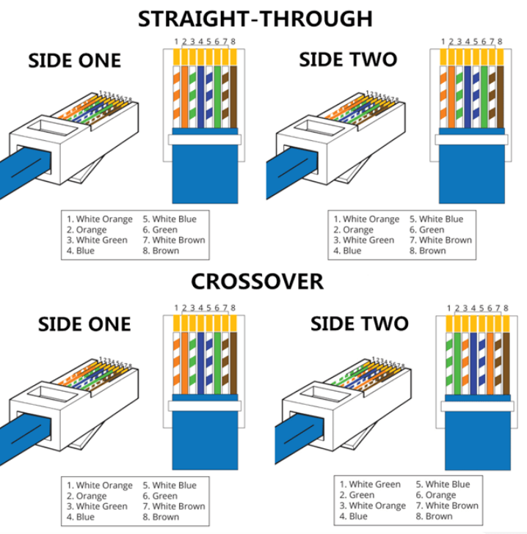
RJ45 Registered Jack

Slide 3
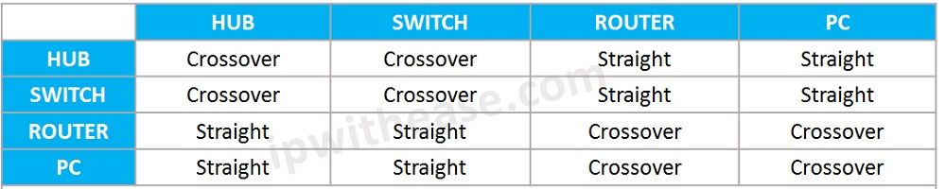
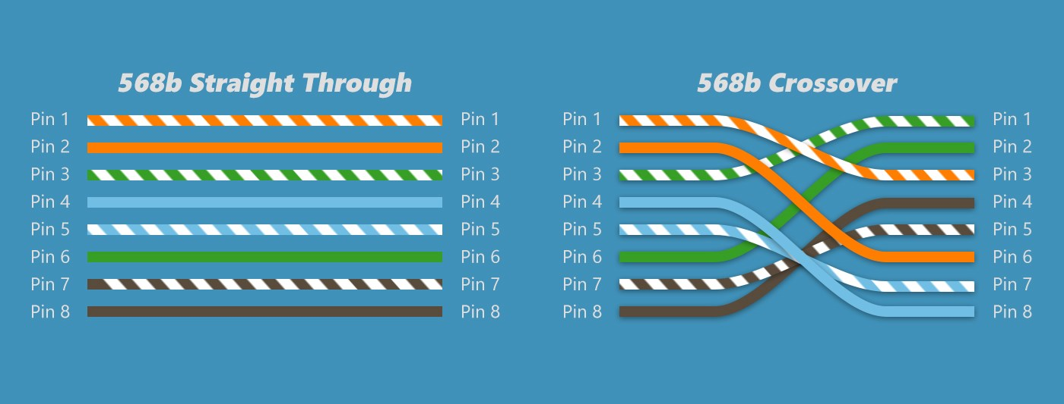
Uses of cable

Slide 4
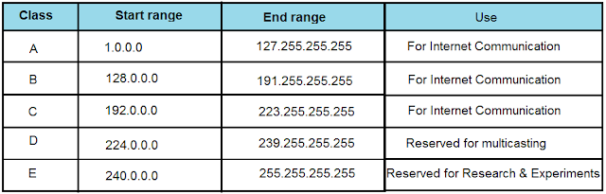
Type of IP address

Slide 5
Poll
D class of internet is used for internet communication
True
False

Slide 6
Subnet Example
Network address 172.19.0.0 with /16 network mask
Network
Network
Host
Host
172
19
0
0

Slide 7
Poll
IP address contain network address along with host address
True
False

Slide 8
Subnet Example
Network address 172.19.0.0 with /16 network mask
Network
Network
Host
Host
172
19
0
0
Using Subnets: subnet mask 255.255.255.0 or /24
Network
Network
Subnet
Host
Network Mask: 255.255.0.0 or /16
11111111
11111111
00000000
00000000
Subnet Mask: 255.255.255.0 or /24
11111111
11111111
11111111
00000000
Applying a mask which is larger than the default subnet mask, will divide your network into subnets.
Subnet mask used here is 255.255.255.0 or /24

Slide 9
Subnet Example
Class B address 172.19.0.0 with /16 network mask
Using Subnets: subnet mask 255.255.255.0 or /24
Hosts Addresses
Network
Network
Subnet
Hosts
172
19
0
1
254
172
19
1
1
254
172
19
2
1
254
172
19
3
1
254
172
19
etc.
1
254
172
19
254
1
254
Each subnet has 254 hosts, 2⁸ – 2
172
19
255
Host

Slide 10
Subnet Example
Network address 172.19.0.0 with /16 network mask
Using Subnets: subnet mask 255.255.255.0 or /24
Network
Network
Subnet
Host
172
19
0
255
Broadcast Addresses
172
19
1
255
172
19
2
255
255 Subnets
2⁸ - 1
172
19
3
255
172
19
etc.
255
172
19
254
255
Cannot use last subnet as it contains broadcast address
172
19
255
255

Slide 11
Poll
last subnet Cannot be used as it contains broadcast address
True
False

Slide 12
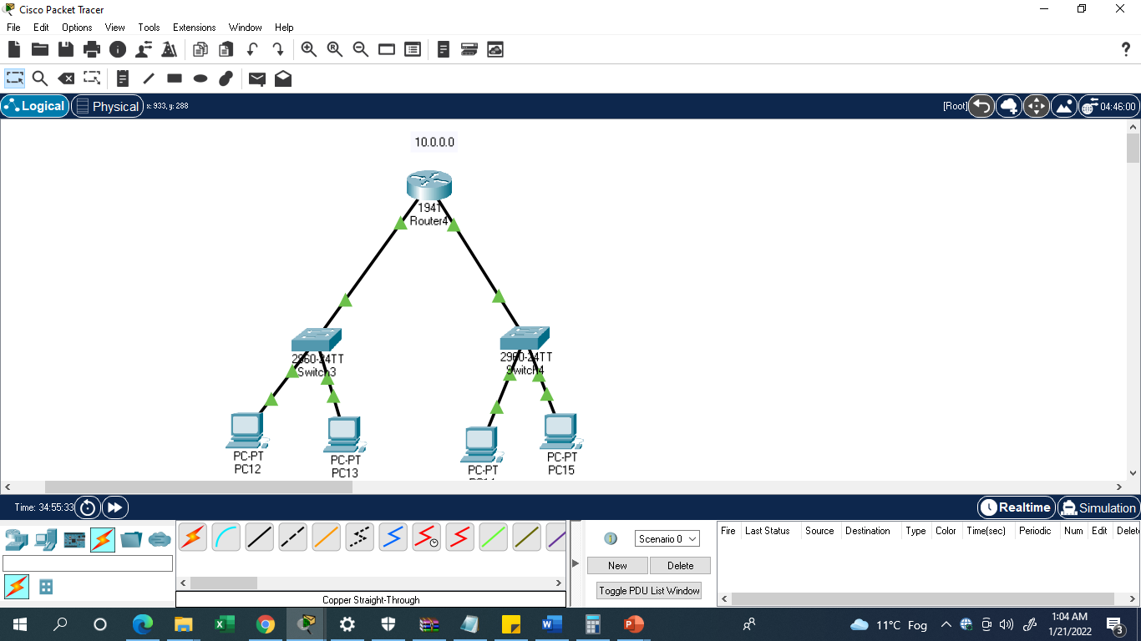
Single router network

Slide 13
CLI Router (command line interface)
--- System Configuration Dialog ---
Would you like to enter the initial configuration dialog? [yes/no]: no
Press RETURN to get started!
Router>en
Router#config terminal (privilege mode)
Enter configuration commands, one per line. End with CNTL/Z.
Router(config)#interface GigabitEthernet0/1 (or Router(config)#interface g0/1)
Router(config-if)#ip add 20.0.0.1 255.0.0.0
Router(config-if)#no shutdown

Slide 14
Router#config terminal
Enter configuration commands, one per line. End with CNTL/Z.
Router(config)#interface g0/0
Router(config-if)#ip add 10.0.0.1 255.0.0.0
Router(config-if)#no shutdown

Slide 15
FLSM subnetting (fixed length subnet mask)
Step 1:decide total number of sub net required , lets say 2
Step 2: calculate required subnet bits for example in assumed case
255.255.255. 10000000 (2^8= 256 formula used)
Step 3: calculate subnet mask by converting this binary number to decimal for eg.
10000000 =128 hence mask will be: 255.255.255.128
Step 4: Find range by subtracting calculated mask from maximum possible number 255.255.255.255
255.255.255.255
255.255.255.128
-----------------------
0.0.0.127
Range will be
10.10.10.0 to 10.10.0.127
And
10.10.10.128 to 10.10.10.255

Slide 16
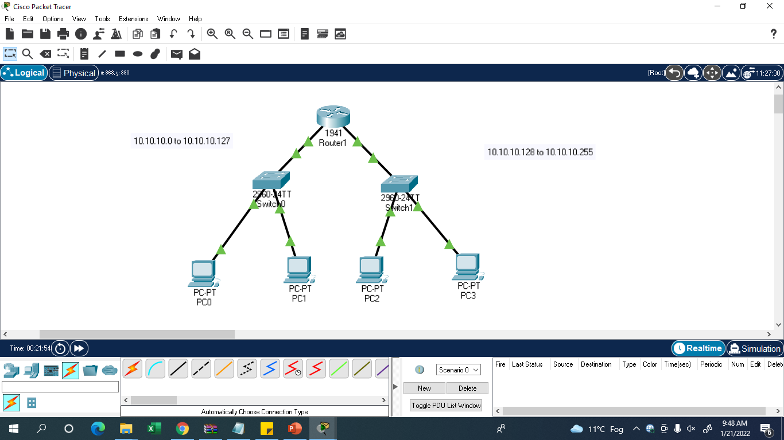

Slide 17
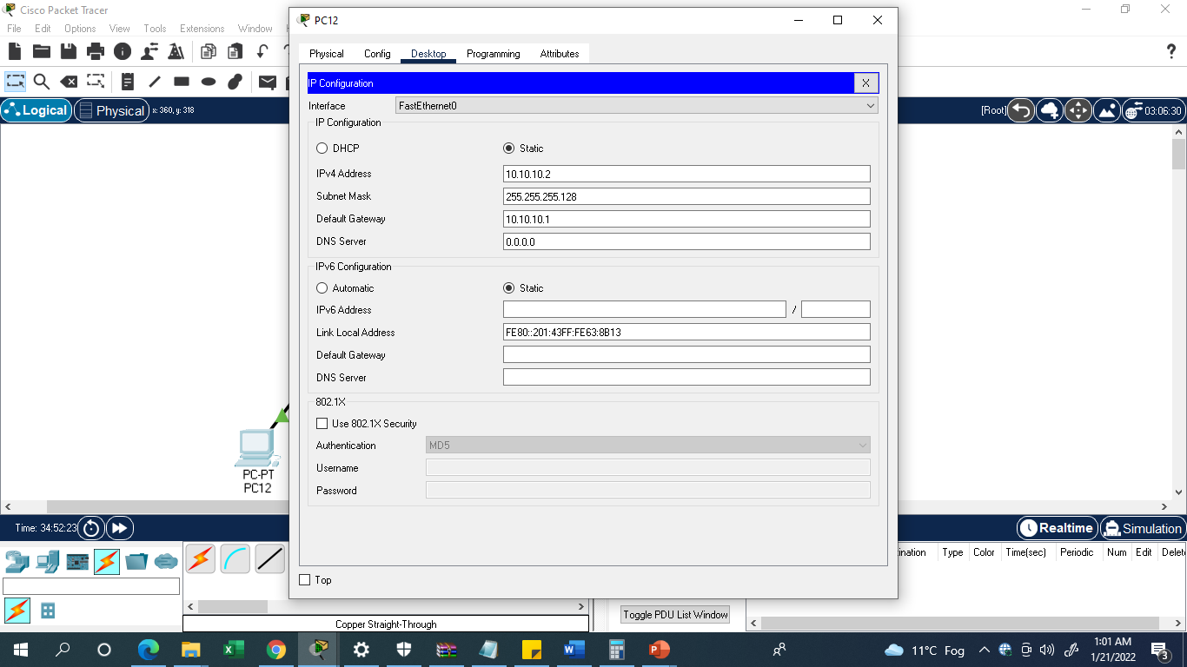
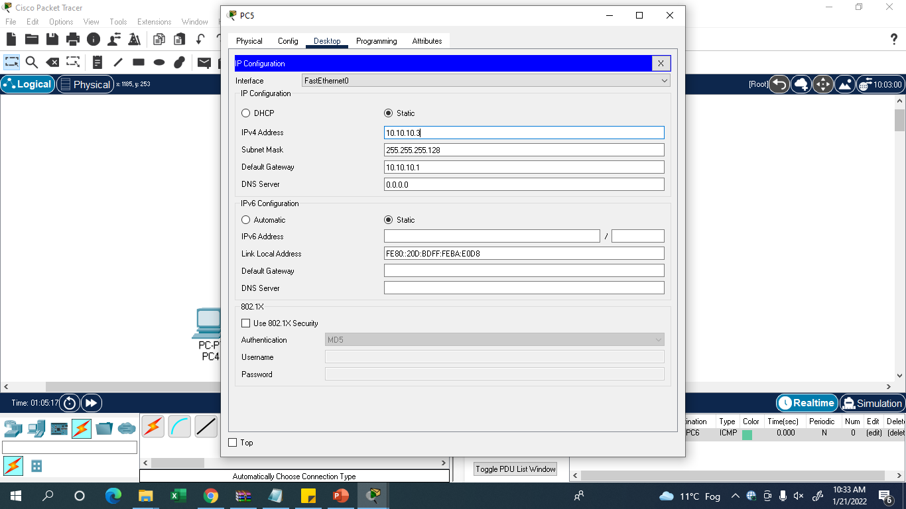
Sample of pc setting

Slide 18
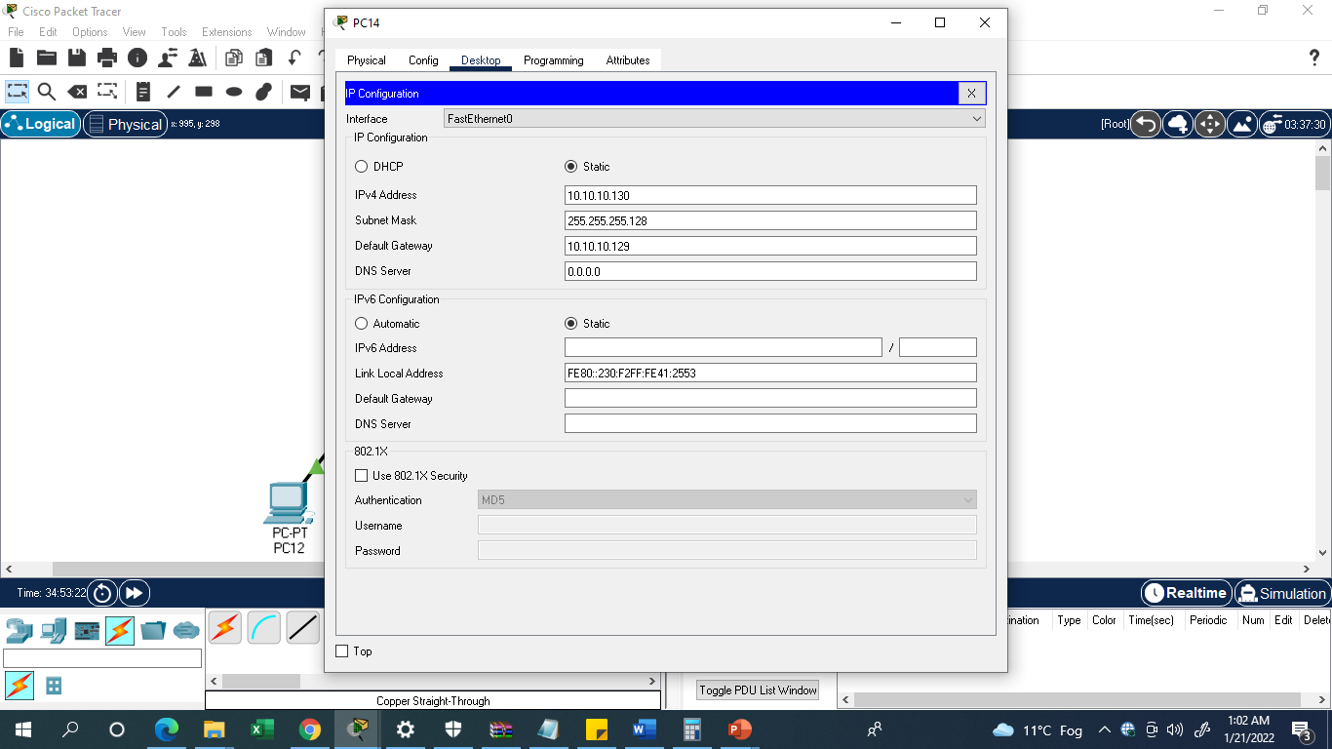

Sample of pc setting

Slide 19
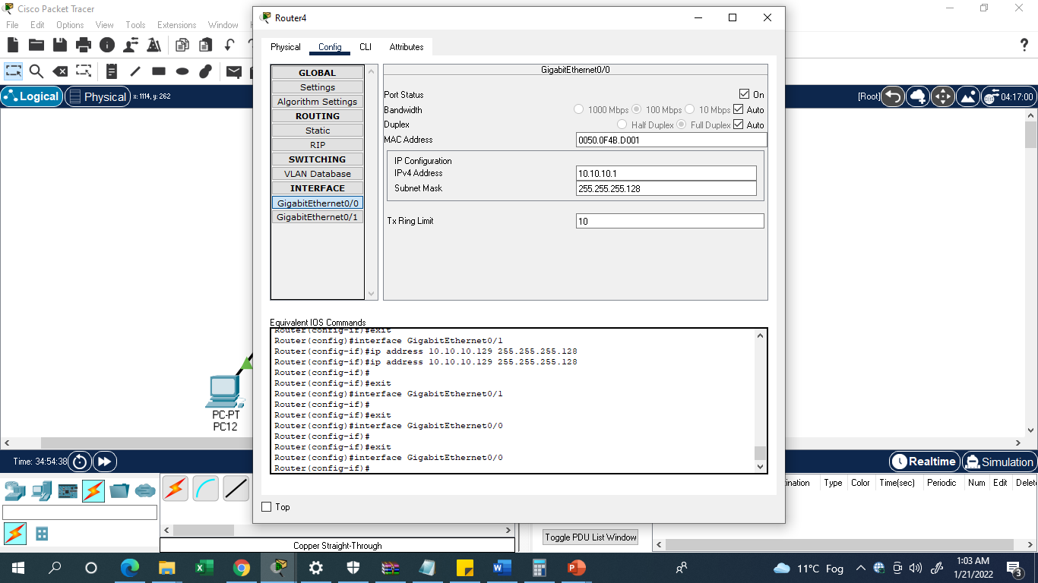

Router setting

Slide 20
VLSM subnetting (variable length subnet mask)
Step 1:decide total number of sub net required , lets say 2
Step 2: calculate required network bits for example in assumed case network one need 64 IP’s and rest IP’s belong to network two
32-6=26 bits
(2^n formula used and 32 is (8.8.8.8 total no of bits ))
Step 3: calculate subnet mask by converting this binary number to decimal for eg.
11000000 =192 hence mask will be: 255.255.255.192
Step 4: Find range by subtracting calculated mask from maximum possible number 255.255.255.255
255.255.255.255
255.255.255.192
-----------------------
0.0.0.63
Range will be
10.10.10.0 to 10.10.0.63

Slide 21
VLSM subnetting
Step 1:decide total number of sub net required , lets say 2
Step 2: calculate required network bits for example is assumed case network one need 30 IP’s and rest IP’s belong to network two
32-5=27 bits
(2^n formula used and 32 is (8.8.8.8 total no of bits ))
Step 3: calculate subnet mask by converting this binary number to decimal for eg.
11100000 =224 hence mask will be: 255.255.255.224
Step 4: Find range by subtracting calculated mask from maximum possible number 255.255.255.255 (
255.255.255.255
255.255.255.224
-----------------------
0.0.0.31
Range will be
10.10.10.64 to 10.10.0.95

Slide 22
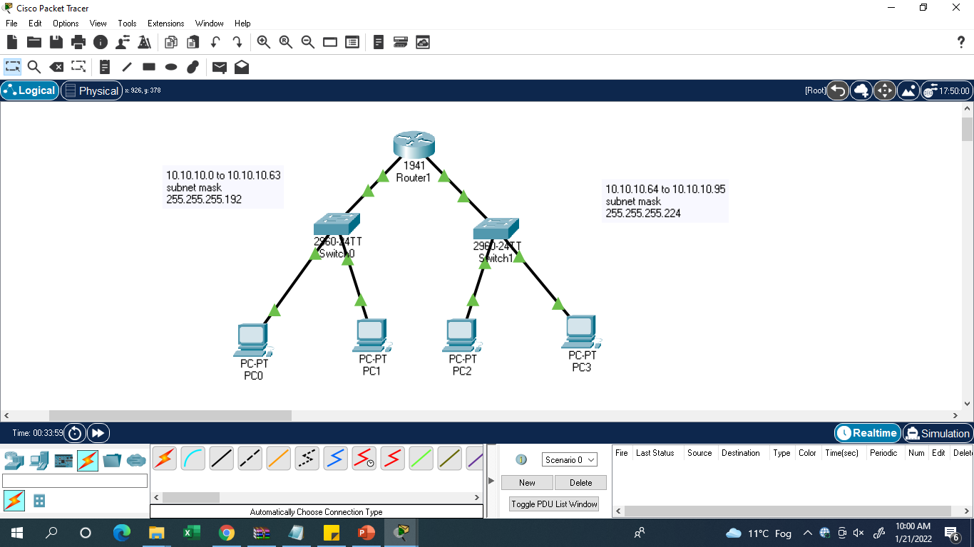

Slide 23
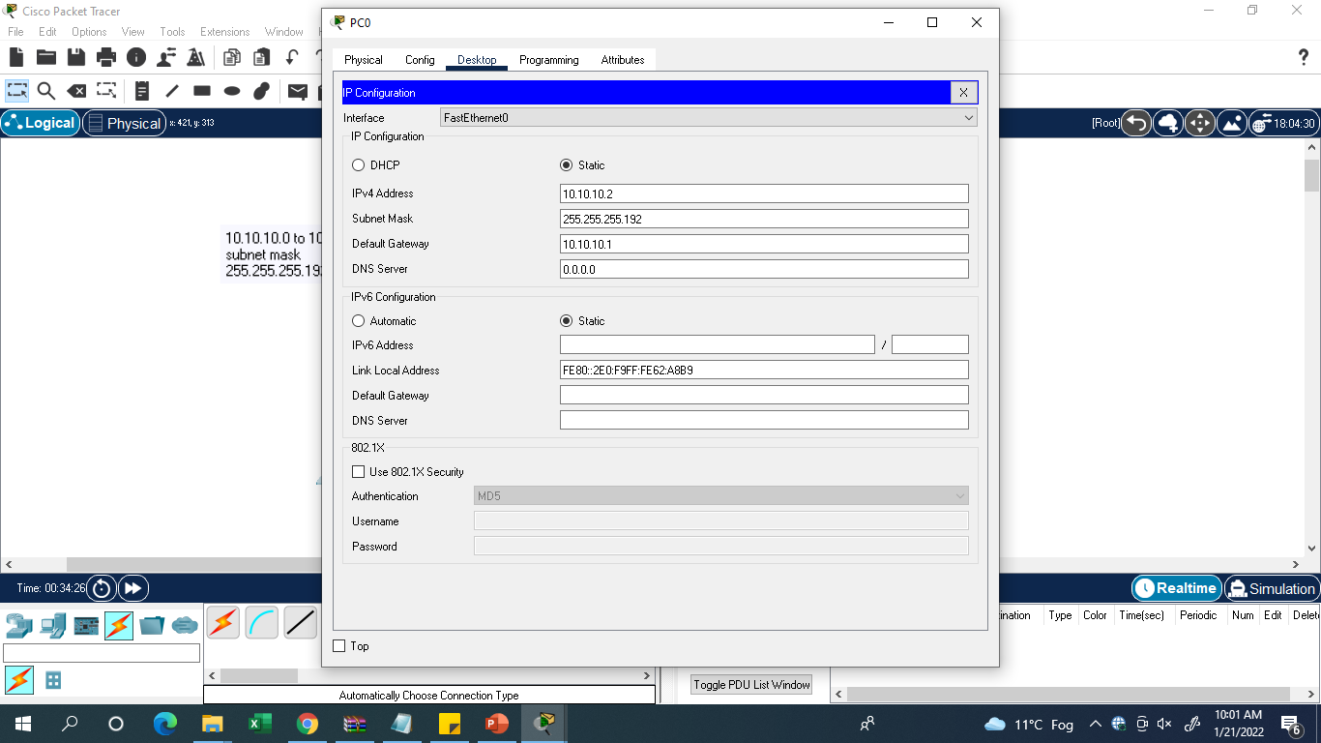


Slide 24
